Slide 1
This presentation is aimed at demonstrating an approach to teaching and learning in mathematics that is practical and context rich. Teaching maths in this way allows for the development of competencies such as communication and problem solving. This presentation can be used to explain to student teachers how to teach maths in an exciting way. It can also be used directly with P2 or P3 students. The materials should be adapted further to use other number patterns and other contexts. Suggested other contexts include: counting wheels on different modes of transport; counting fingers amongst groups of learners; counting legs on tables and chairs; counting groups of stones after pattern making.

Slide 2
Intended Learning Outcomes:
I can count in multiples of 2.
I can work with other people to solve maths problems involving multiplication.

Slide 3
We are going on a journey around the world…

Slide 4
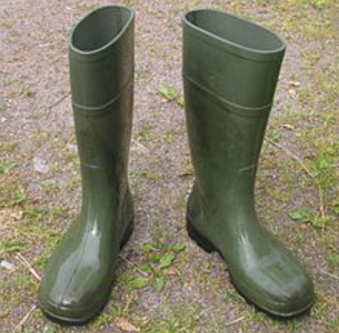
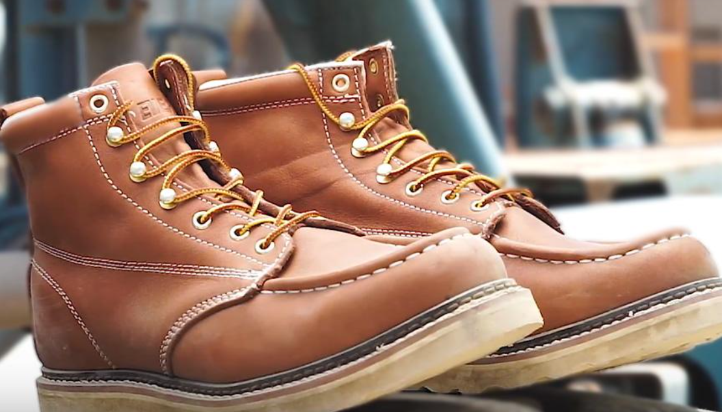
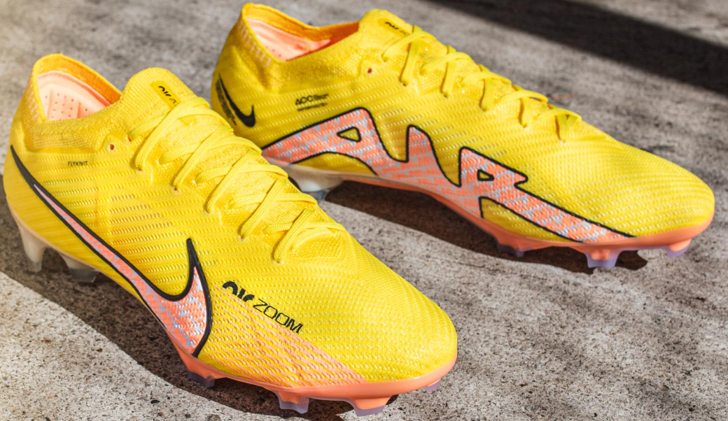
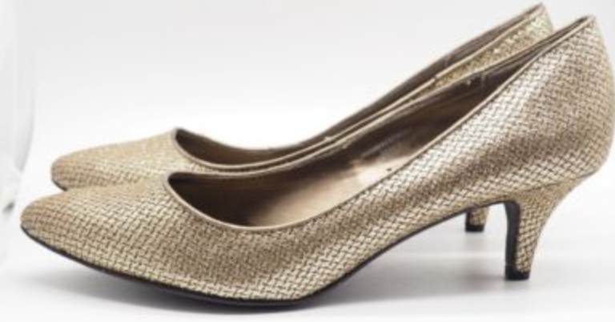
Shoes are made for walking!
Where could these shoes take you?
How are each pair of shoes different and how are they the same?

Slide 5
What shoes would you wear here?

Slide 6
What shoes would you wear here?

Slide 7
What shoes would you wear here?

Slide 8
What shoes would you wear here?

Slide 9
What shoes would you wear here?

Slide 10
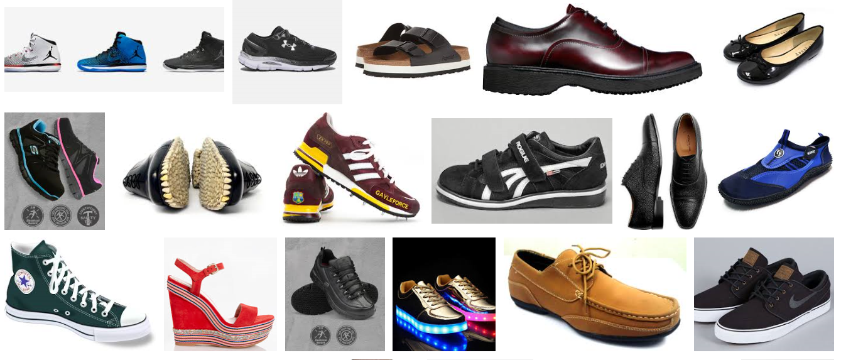
What a lot of shoes! How many pairs can you see?

Slide 11
Walking Shoes Poem!
The shoes went walking two by two – whoo, whoo!!
The shoes went walking two by two – whoo, whoo!
The shoes went walking two by two,
Around the word for you and you,
And the shoes kept walking two, by two, by two!

Slide 12
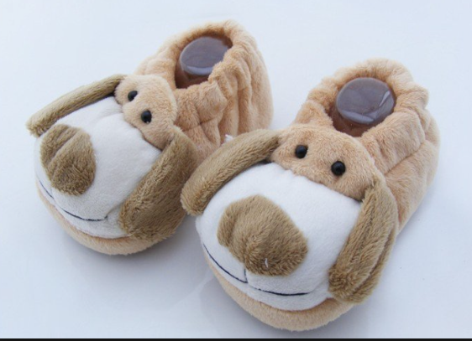
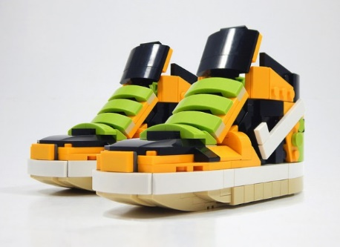
2 + 2 + 2 = 6
3 x 2 = 6

Slide 13
3 x 2 = 6
2 + 2 + 2 = 6

Slide 14
What other sums can you create thinking about pairs of shoes?
What else can you think of that comes in pairs? Or twos?

Slide 15
Learning outcomes:
I can count in multiples of 2.
I can work with other people to solve maths problems involving multiplication.

